Slide 1
Computer Networks
CSE405
Network Layer
Rabea Khatun
Lecturer
Dept. Of CSE
East West University

Slide 2

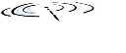




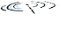






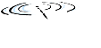


Network-layer services and protocols
transport segment from sending to receiving host
sender: encapsulates segments into datagrams, passes to link layer
receiver: delivers segments to transport layer protocol
network layer protocols in every Internet device: hosts, routers
routers:
examines header fields in all IP datagrams passing through it
moves datagrams from input ports to output ports to transfer datagrams along end-end path
mobile network
national or global ISP
application
transport
network
link
physical
network
link
physical
network
link
physical
network
link
physical
network
link
physical
network
link
physical
datacenter
network
application
transport
network
link
physical
enterprise
network

Slide 3
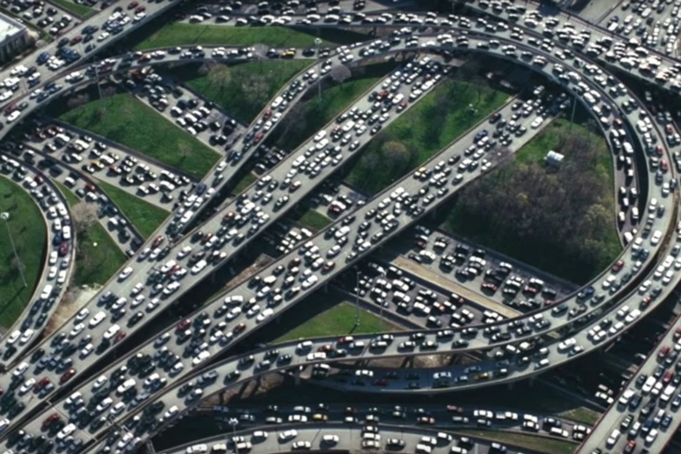
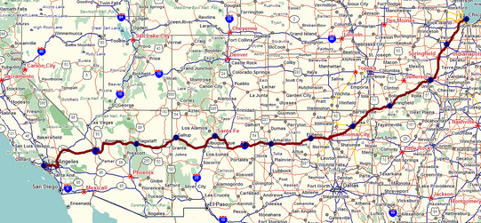
Two key network-layer functions
network-layer functions:
forwarding: move packets from a router’s input link to appropriate router output link
analogy: taking a trip
forwarding: process of getting through single interchange
routing: process of planning trip from source to destination
routing: determine route taken by packets from source to destination
routing algorithms
forwarding
routing

Slide 4
Network layer: data plane, control plane
Data plane:
local, per-router function
determines how datagram arriving on router input port is forwarded to router output port
Control plane
network-wide logic
determines how datagram is routed among routers along end-end path from source host to destination host
values in arriving
packet header
0111
1
3
2

Slide 5

Per-router control plane
Individual routing algorithm components in each and every router interact in the control plane
Routing
Algorithm
control
plane
data
plane
values in arriving
packet header
0111
1
3
2

Slide 6
Connection, connection-less service
datagram network provides network-layer connectionless service
virtual-circuit network provides network-layer connection service
analogous to TCP/UDP connecton-oriented / connectionless transport-layer services, but:
service: host-to-host
no choice: network provides one or the other
implementation: in network core

Slide 7
Virtual circuits
“source-to-dest path behaves much like telephone circuit”
call setup, teardown for each call before data can flow
each packet carries VC identifier (not destination host address)
link, router resources (bandwidth, buffers) may be allocated to VC (dedicated resources = predictable service)

Slide 8
VC implementation
a VC consists of:
path from source to destination
VC numbers, one number for each link along path
entries in forwarding tables in routers along path
packet belonging to VC carries VC number (rather than dest address)
VC number can be changed on each link.
new VC number comes from forwarding table

Slide 9

VC forwarding table
12
22
32
1
3
2
VC number
forwarding table in
northwest router:
interface
number
Incoming interface Incoming VC # Outgoing interface Outgoing VC #
1 12 3 22
2 63 1 18
3 7 2 17
1 97 3 87
… … … …
VC routers maintain connection state information!

Slide 10

Virtual circuits: signaling protocols
used to setup, maintain teardown VC
used in ATM, frame-relay, X.25
not used in today’s Internet
application
transport
network
data link
physical
application
transport
network
data link
physical
5. data flow begins
6. receive data
4. call connected
3. accept call
1. initiate call
2. incoming call

Slide 11
Datagram networks
no call setup at network layer
routers: no state about end-to-end connections
no network-level concept of “connection”
packets forwarded using destination host address
application
transport
network
data link
physical
application
transport
network
data link
physical
1. send datagrams
2. receive datagrams

Slide 12
Datagram forwarding table
4 billion IP addresses, so rather than list individual destination address
list range of addresses
(aggregate table entries)
routing algorithm
local forwarding table
dest address
output link
address-range 1
address-range 2
address-range 3
address-range 4
3
2
2
1
IP destination address in
arriving packet’s header
1
3
2

Slide 13
Datagram forwarding table
Destination Address Range
11001000 00010111 00010000 00000000
through
11001000 00010111 00010111 11111111
11001000 00010111 00011000 00000000
through
11001000 00010111 00011000 11111111
11001000 00010111 00011001 00000000
through
11001000 00010111 00011111 11111111
otherwise
Link Interface
0
1
2
3
Q: but what happens if ranges don’t divide up so nicely?

Slide 14
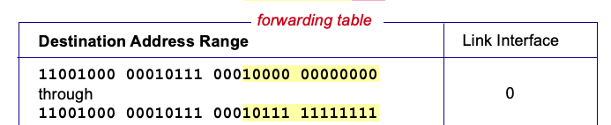
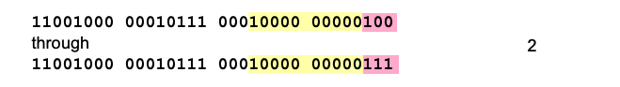
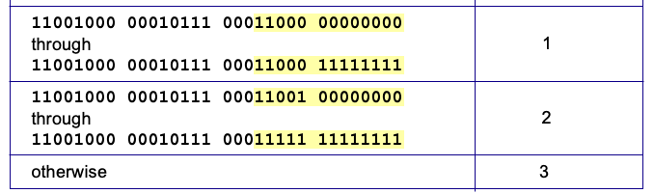
Destination-based forwarding
3
Q: but what happens if ranges don’t divide up so nicely?
Notes:
Text for this animation:
This all works out pretty nice and looks pretty simple!
But of course the devil is in the details, as the saying goes.
What happens, for example, when a subset of addresses say in this first range should go to say interface 3, rather than interface 0. Well, of course we could split the first address range into multiple pieces, and add in this new subrange with its new destination output port. But it turns out there’s a much simpler and elegant way to do this. Known as longest prefix matching.

Slide 15
Longest prefix matching
longest prefix match
when looking for forwarding table entry for given destination address, use longest address prefix that matches destination address.
Destination Address Range
11001000 00010111 00010
11001000 00010111 00011000
11001000 00010111 00011
otherwise
Link interface
0
1
2
3
***
********
********
***
********
examples:
11001000 00010111 00010110 10100001
which interface?
11001000 00010111 00011000 10101010
which interface?

Slide 16
Longest prefix matching
longest prefix match
when looking for forwarding table entry for given destination address, use longest address prefix that matches destination address.
Destination Address Range
11001000 00010111 00010
11001000 00010111 00011000
11001000 00010111 00011
otherwise
Link interface
0
1
2
3
***
********
********
match!
***
********
examples:
11001000 00010111 00010110 10100001
which interface?
11001000 00010111 00011000 10101010
which interface?

Slide 17
Longest prefix matching
longest prefix match
when looking for forwarding table entry for given destination address, use longest address prefix that matches destination address.
Destination Address Range
11001000 00010111 00010
11001000 00010111 00011000
11001000 00010111 00011
otherwise
Link interface
0
1
2
3
***
********
********
***
********
match!
examples:
11001000 00010111 00010110 10100001
which interface?
11001000 00010111 00011000 10101010
which interface?

Slide 18
Longest prefix matching
longest prefix match
when looking for forwarding table entry for given destination address, use longest address prefix that matches destination address.
Destination Address Range
11001000 00010111 00010
11001000 00010111 00011000
11001000 00010111 00011
otherwise
Link interface
0
1
2
3
***
********
********
***
********
match!
examples:
11001000 00010111 00010110 10100001
which interface?
11001000 00010111 00011000 10101010
which interface?

Slide 19
IP Datagram format
32 bits
IP protocol version number
head.
len
type of
service
total datagram
length (bytes)
ver
length
header length(bytes)
“type” of service:
flgs
fragment
offset
fragmentation/
reassembly
16-bit identifier
time to
live
upper
layer
header
checksum
header checksum
TTL: remaining max hops
(decremented at each router)
source IP address
32-bit source IP address
destination IP address
32-bit destination IP address
upper layer protocol (e.g., TCP or UDP)
options (if any)
e.g., timestamp,
payload data
(variable length,
typically a TCP
or UDP segment)

Slide 20
IP fragmentation/reassembly
network links have MTU (max. transfer size) - largest possible link-level frame
different link types, different MTUs
large IP datagram divided (“fragmented”) within net
one datagram becomes several datagrams
“reassembled” only at destination
IP header bits used to identify, order related fragments
…
fragmentation:
in: one large datagram
out: 3 smaller datagrams
reassembly
…

Slide 21
IP fragmentation/reassembly
example:
4000 byte datagram
MTU = 1500 bytes
length
=4000
ID
=x
fragflag
=0
offset
=0
one large datagram becomes
several smaller datagrams
1480 bytes in data field
length
=1500
ID
=x
fragflag
=1
offset
=0
offset =
1480/8
length
=1500
ID
=x
fragflag
=1
offset
=185
length
=1040
ID
=x
fragflag
=0
offset
=370

Slide 22
IP addressing: introduction
223.1.1.1
IP address: 32-bit identifier associated with each host or router interface
interface: connection between host/router and physical link
router’s typically have multiple interfaces
host typically has one or two interfaces (e.g., wired Ethernet, wireless 802.11)
IP addresses associated with each interface
Written in dotted-decimal notations
223.1.2.1
223.1.1.2
223.1.1.4
223.1.2.9
223.1.1.3
223.1.3.27
223.1.2.2
223.1.3.1
223.1.3.2
dotted-decimal IP address notation:
223.1.1.1 = 11011111 00000001 00000001 00000001
223
1
1
1

Slide 23
IP addressing: introduction
223.1.1.1
IP address: 32-bit identifier associated with each host or router interface
interface: connection between host/router and physical link
router’s typically have multiple interfaces
host typically has one or two interfaces (e.g., wired Ethernet, wireless 802.11)
223.1.2.1
223.1.1.2
223.1.1.4
223.1.2.9
223.1.1.3
223.1.3.27
223.1.2.2
223.1.3.1
223.1.3.2
dotted-decimal IP address notation:
223.1.1.1 = 11011111 00000001 00000001 00000001
223
1
1
1

Slide 24
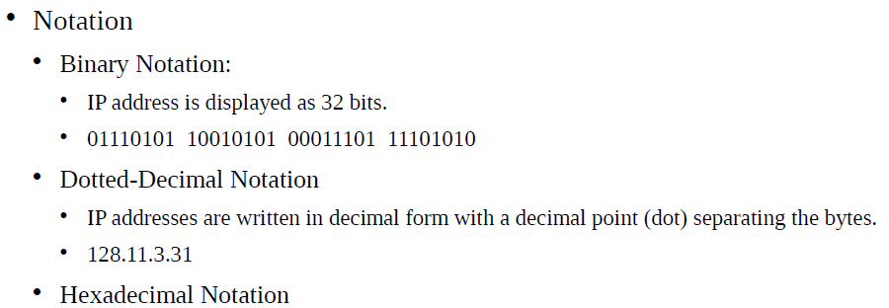
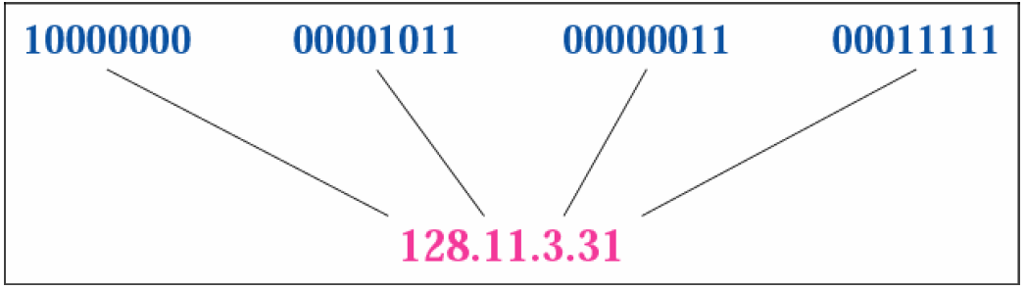
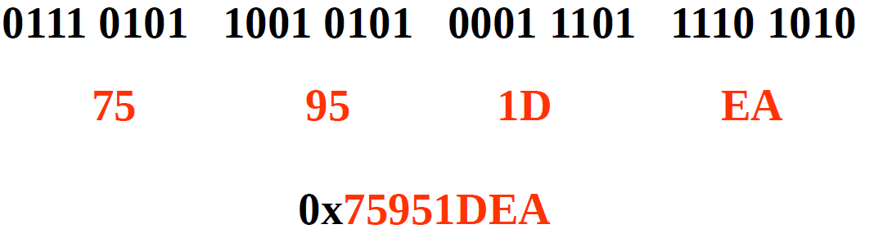
IP addressing
Binary Notation
Hexadecimal Notation

Slide 25
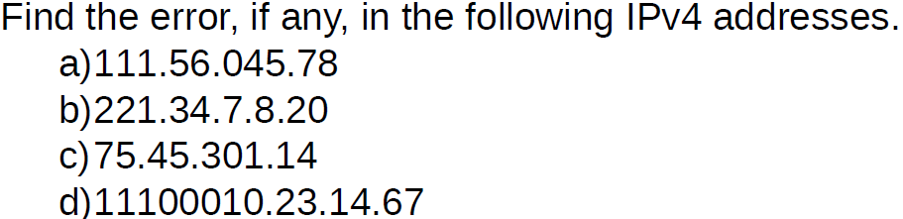
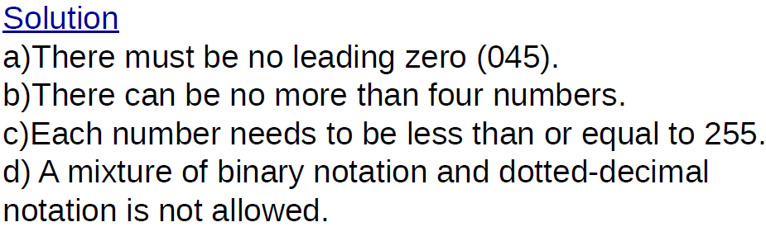
IP addressing

Slide 26
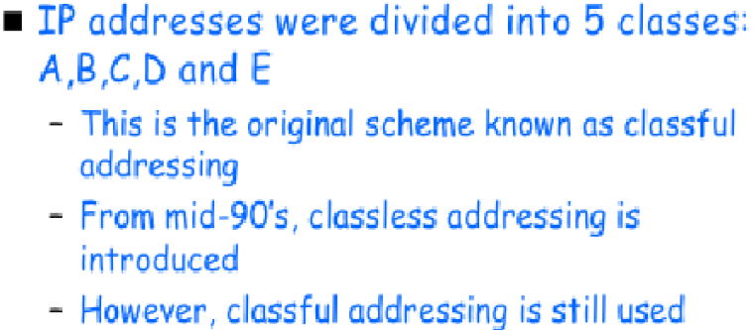
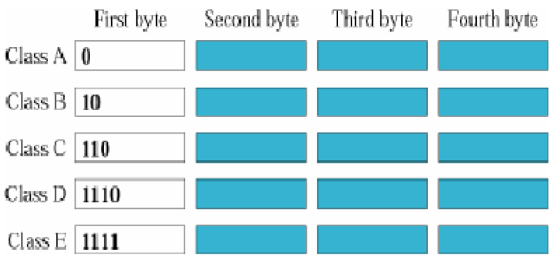
IP addressing (Classful Addressing)

Slide 27
Example
Find the class of each address.
a. 00000001 00001011 00001011 11101111
b. 11000001 10000011 00011011 11111111
c. 14.23.120.8
d. 252.5.15.111
Solution
a. The first bit is 0. This is a class A address.
b. The first 2 bits are 1; the third bit is 0. This is a class C address.
c. The first byte is 14; the class is A.
d. The first byte is 252; the class is E.

Slide 28
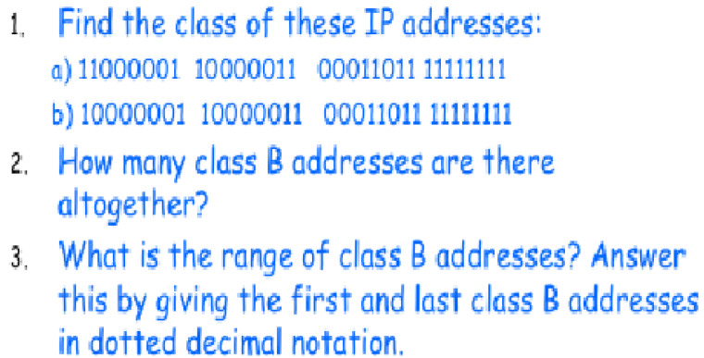
IP addressing (Classful Addressing)
Exercise:

Slide 29
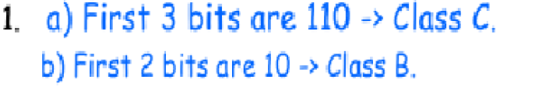
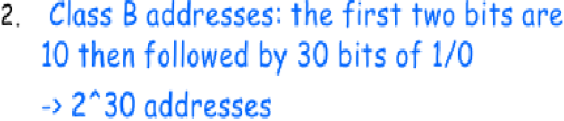
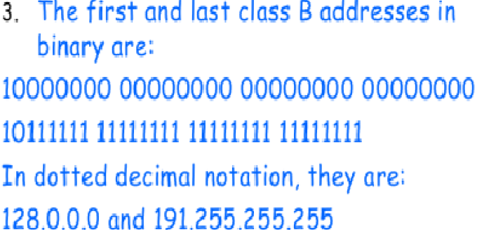
IP addressing (Classful Addressing)
Solution:

Slide 30
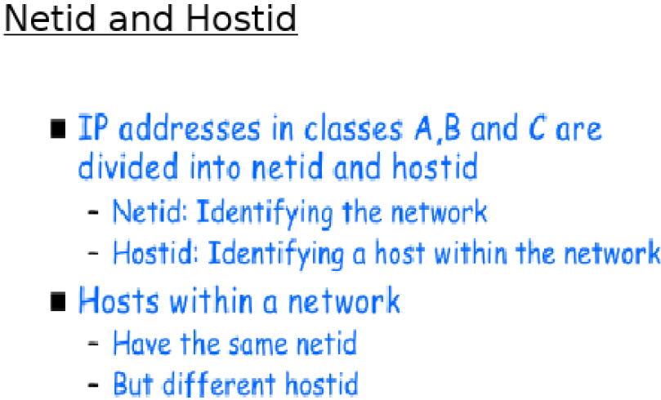
IP addressing (Classful Addressing)

Slide 31
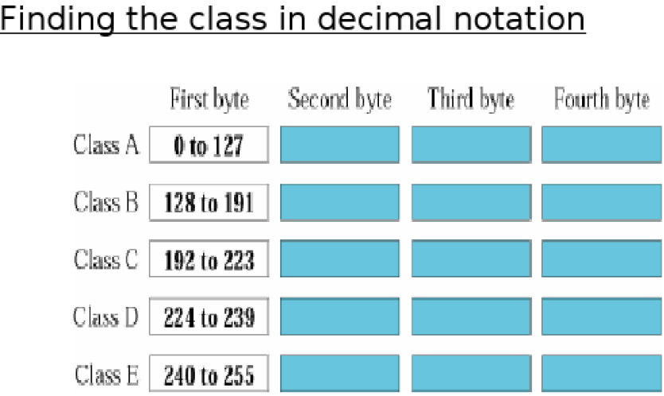
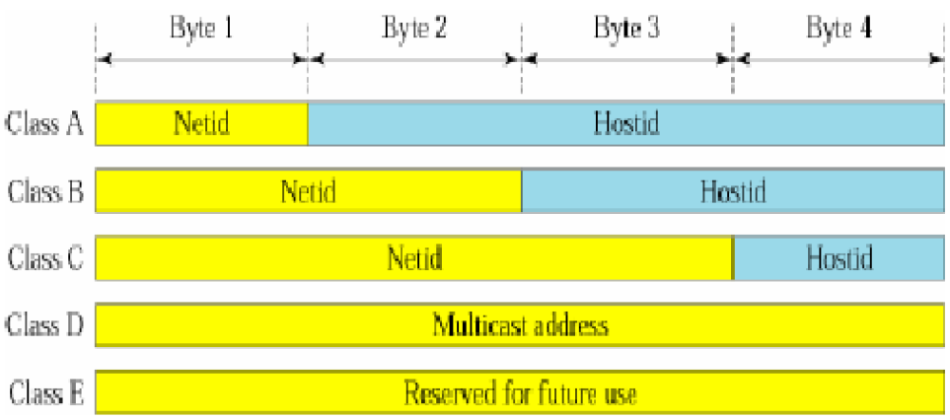
IP addressing (Classful Addressing)

Slide 32
Problem
How can we prove that we have 2,147,483,648 addresses in class A?
Solution
In class A, only 1 bit defines the class. The remaining 31 bits are available for the address.
With 31 bits, we can have 2³¹ or 2,147,483,648 addresses.

Slide 33
Problem
Given the network address 17.0.0.0, find the class, the block, and the range of the addresses.
Solution
The class is A because the first byte is between 0 and 127. The block has a netid of 17 (00010001). The addresses range from 17.0.0.0 to 17.255.255.255.

Slide 34
Problem
Given the network address 132.21.0.0, find the class, the block, and the range of the addresses.
Solution
The class is B because the first byte is between 128 and 191. The block has a netid of 132.21. The addresses range from 132.21.0.0 to 132.21.255.255.

Slide 35
Problem
Given the network address 220.34.76.0, find the class, the block, and the range of the addresses.
Solution
The class is C because the first byte is between 192 and 223. The block has a netid of 220.34.76. The addresses range from 220.34.76.0 to 220.34.76.255.

Slide 36
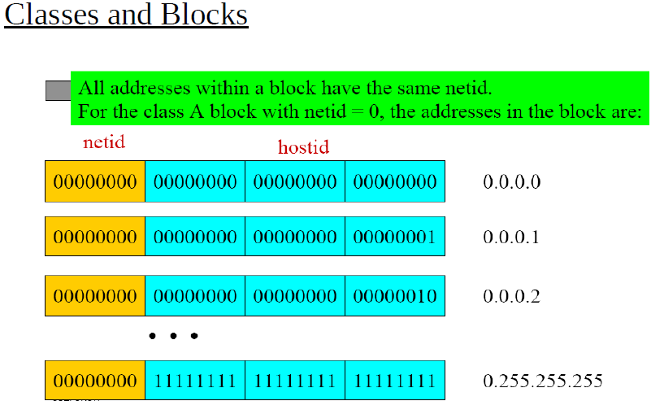
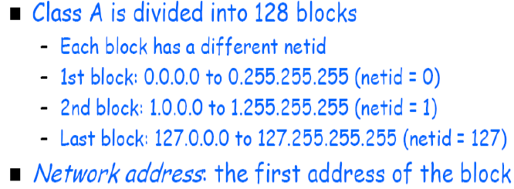
IP addressing (Classful Addressing)

Slide 37
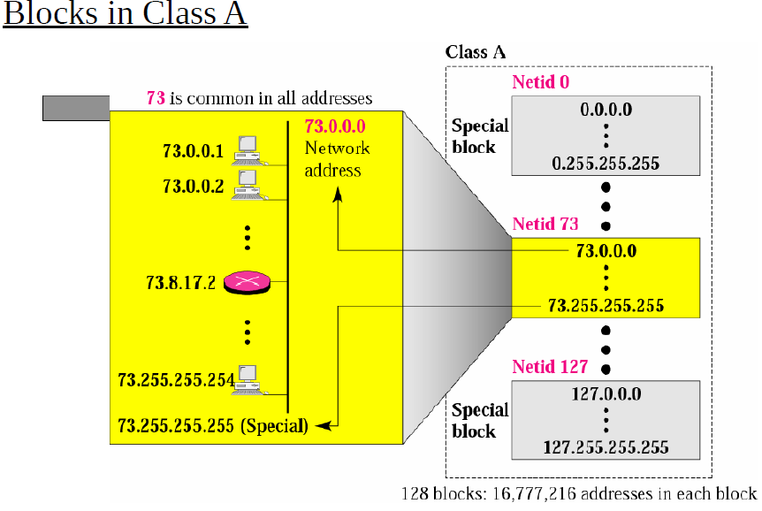
IP addressing (Classful Addressing)

Slide 38
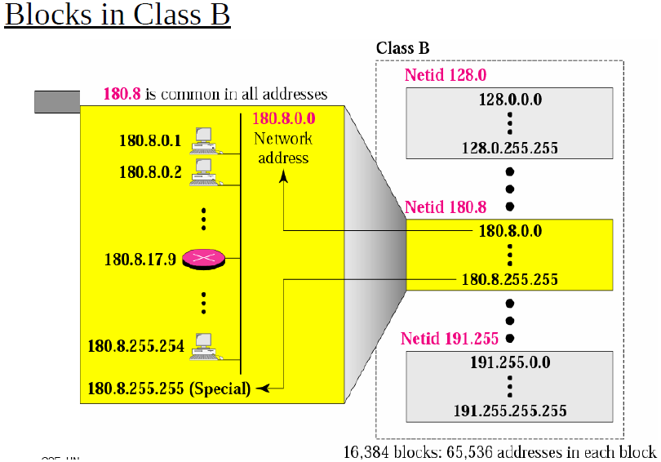
IP addressing (Classful Addressing)

Slide 39
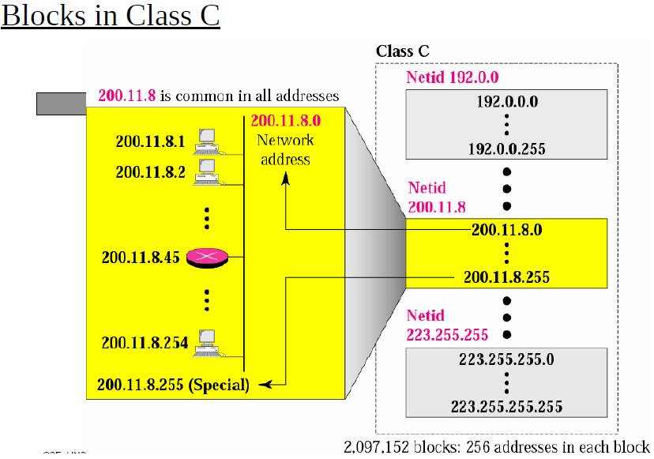
IP addressing (Classful Addressing)

Slide 40
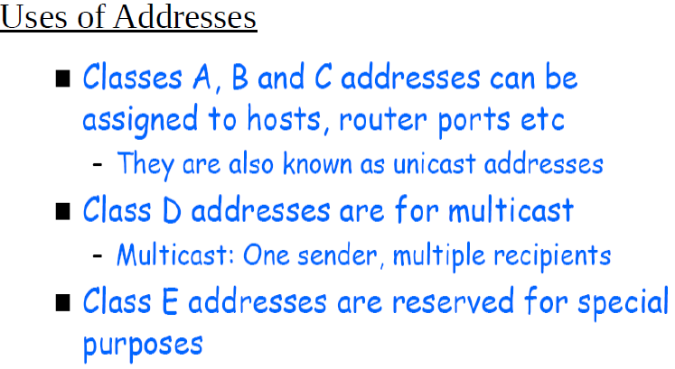
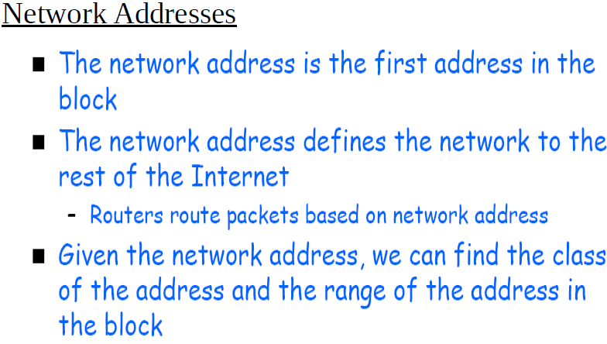
IP addressing (Classful Addressing)

Slide 41

IP addressing: Classless Addressing
Limitation of Classful Addressing
Note
In classful addressing, a large part of the available addresses were wasted.
Classful addressing, which is almost obsolete, is replaced with classless addressing.

Slide 42
How do we or devices identify the network part or the host part?
How do we or devices identify the network part or the host part?
Answer: For us :Using the “Prefix Mask”.
192.168.10.2/24 Means that the first 24 bits are the network portion. The last 8 bits are the host portion.

Slide 43
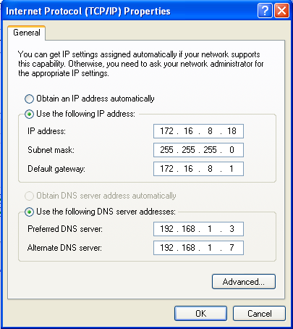
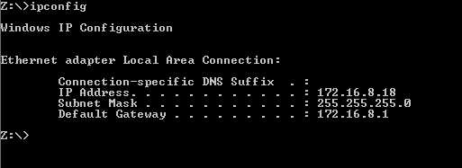
How do we or devices identify the network part or the host part?
Answer: For devices Using the “subnet mask”.
255.255.255.0

Slide 44
Prefix or Subnet Mask
The Prefix Mask and the Subnet Mask are different ways of representing the same information.
Prefix Mask of /24 or a subnet mask of 255.255.255.0
Prefix Mask of /16 or a subnet mask of 255.255.0.0
Prefix Mask of /8 or a subnet mask of 255.0.0.0

Slide 45
Subnet Mask
IP Address: 10.24.36.2 / 8 Subnet Mask?
IP Address: 10.24.36.2 / 12 Subnet Mask?
IP Address: 10.24.36.2 / 16 Subnet Mask?
IP Address: 10.24.36.2 / 23 Subnet Mask?
IP Address: 10.24.36.2 255.255.224.0 Prefix Mask?
IP Address: 10.24.36.2 255.255.255.192 Prefix Mask?
IP Address: 10.24.36.2 255.255.255.252 Prefix Mask?
IP Address: 10.24.36.2 255.254.0.0 Prefix Mask?
IP Address: 10.24.36.2 255.255.240.0 Prefix Mask?

Slide 46
IP addressing: CIDR
CIDR: Classless InterDomain Routing (pronounced “cider”)
subnet portion of address of arbitrary length
address format: a.b.c.d/x, where x is # bits in subnet portion of address
subnet
part
host
part
11001000 00010111 00010000 00000000
200.23.16.0/23

Slide 47
Subnets
223.1.1.1
What’s a subnet ?
device interfaces that can physically reach each other without passing through an intervening router
223.1.2.1
223.1.1.2
223.1.1.4
223.1.2.9
223.1.1.3
223.1.3.27
223.1.2.2
IP addresses have structure:
subnet part: devices in same subnet have common high order bits
host part: remaining low order bits
223.1.3.1
223.1.3.2
network consisting of 3 subnets

Slide 48
Subnets
subnet 223.1.1.0/24
223.1.1.1
subnet 223.1.2.0/24
Recipe for defining subnets:
detach each interface from its host or router, creating “islands” of isolated networks
each isolated network is called a subnet
223.1.2.1
223.1.1.2
223.1.1.4
223.1.2.9
223.1.1.3
223.1.3.27
223.1.2.2
subnet
223.1.3.0/24
223.1.3.1
223.1.3.2
subnet mask: /24
(high-order 24 bits: subnet part of IP address)

Slide 49
Subnets
223.1.1.2
subnet 223.1.1/24
where are the subnets?
what are the /24 subnet addresses?
223.1.1.1
223.1.1.4
223.1.1.3
223.1.9.2
223.1.7.0
subnet 223.1.7/24
subnet 223.1.9/24
223.1.9.1
223.1.7.1
223.1.8.1
223.1.8.0
subnet 223.1.2/24
223.1.2.6
subnet 223.1.8/24
223.1.3.27
subnet 223.1.3/24
223.1.2.1
223.1.2.2
223.1.3.1
223.1.3.2

Slide 50
IP addressing: CIDR
MASK
How do we know how many bits represent the network portion and how many bits represent the host portion?
The prefix length is the number of bits in the address that gives us the network portion. For example, in 172.16.4.0 /24, the /24 is the prefix length - it tells us that the first 24 bits are the network address.
another entity that is used to specify the network portion is called subnet mask. The subnet mask consists of 32 bits, just as the address does, and uses 1s and 0s to indicate which bits of the address are network bits and which bits are host bits.

Slide 51
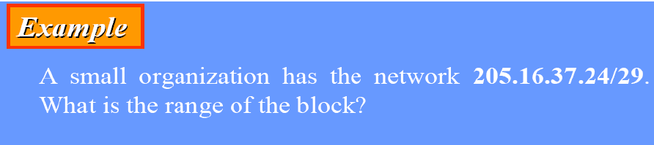
IP addressing (CIDR)
Solution
The binary representation of the given address is
11001111 00010000 00100101 00011000
For first addresses, we set (32−29) = 3 rightmost bits to 0, we get
11001111 00010000 00100101 00011000
For last addresses, we set (32 − 29) = 3 rightmost bits to 1, we get
11001111 00010000 00100101 00011111
The value of n is 29, which means that the range of the block is
2 ³²⁻²⁹or 8.
So, There are only 8 addresses in this block

Slide 52
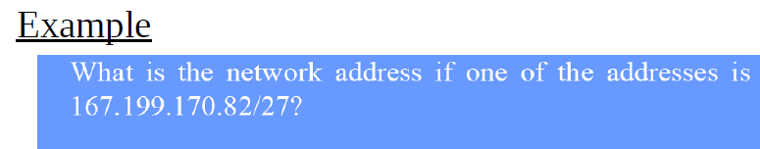
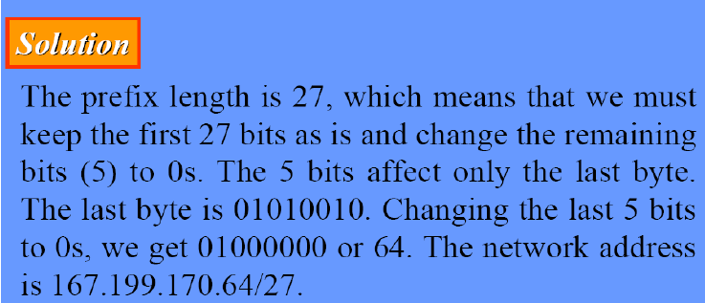
IP addressing (CIDR)

Slide 53
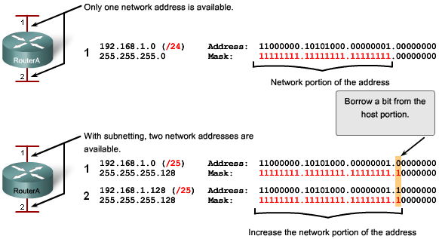
IP addressing (CIDR)
Subnetting allows for creating multiple logical networks from a single address block
Subnets are created using one or more of the host bits as network bits
done by extending the mask to borrow some of the bits from the host portion to create additional network bits

Slide 54
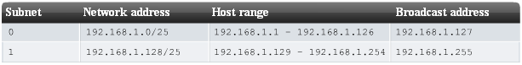
IP addressing (CIDR)
Calculating Subnets and Hosts
The number of subnets is calculated using 2^{n}, where n is the number of bits borrowed
2¹ = 2 subnets
the more bits borrowed, the more subnets can be defined
The number of useable hosts per subnet is calculated using 2^{h} - 2 where h is the number of host bits left
2⁷ – 2 = 126 useable hosts per subnet
with each bit borrowed, fewer host addresses are available per subnet

Slide 55
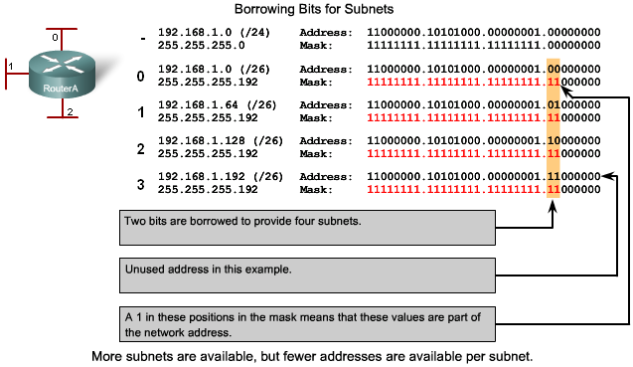
IP addressing (CIDR)
Subnetting Example 1
Need to borrow a minimum of 2 host bits.
2² = 4 subnets

Slide 56
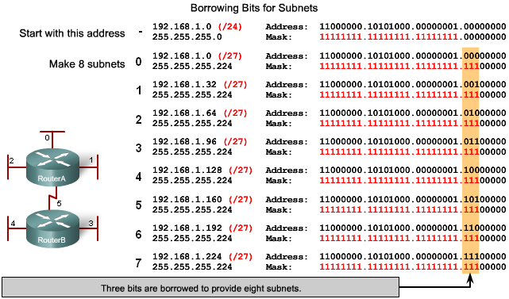
IP addressing (CIDR)
Subnetting Example 2
Need to borrow a minimum of 3 host bits.
2³ = 8 subnets

Slide 57
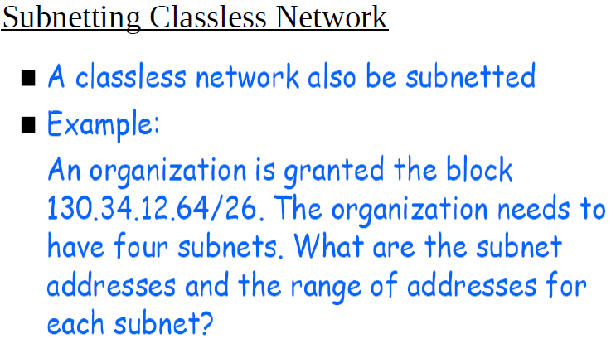
IP addressing (CIDR)

Slide 58
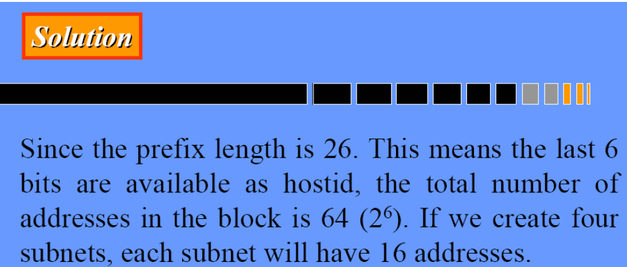
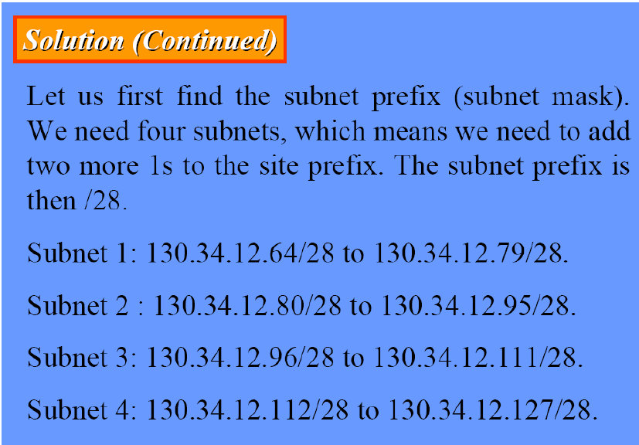
IP addressing (CIDR)

Slide 59
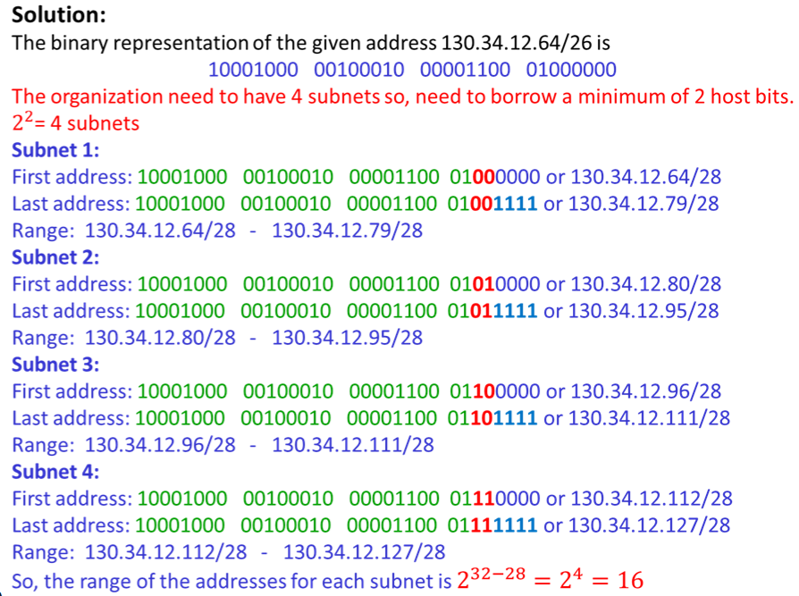
IP addressing (CIDR)

Slide 60
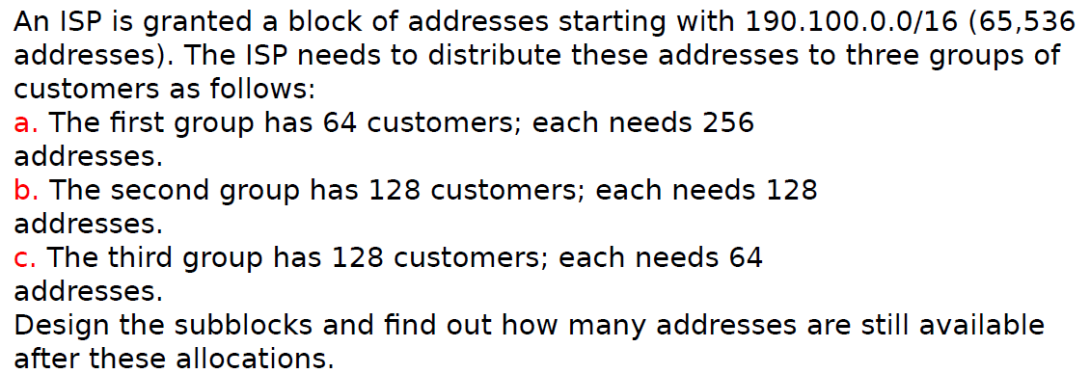
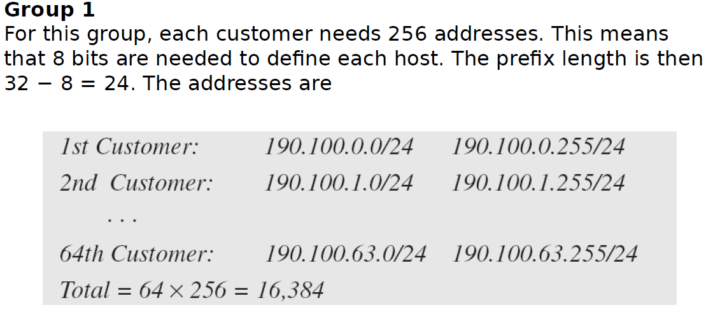
IP addressing (CIDR)

Slide 61
Example
Given the IP address find the following information
IP address : 10.100.20.178 Subnet mask : 255.255.255.240
Network
Broadcast
First usable host
Last usable host
number of usable host addresses

Slide 62
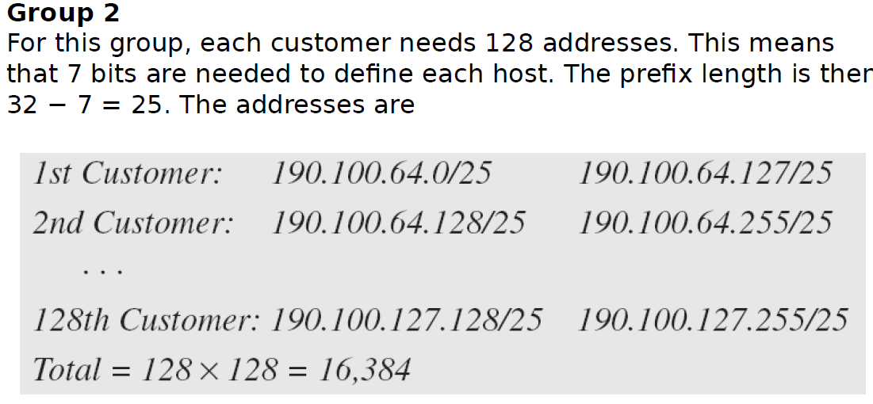
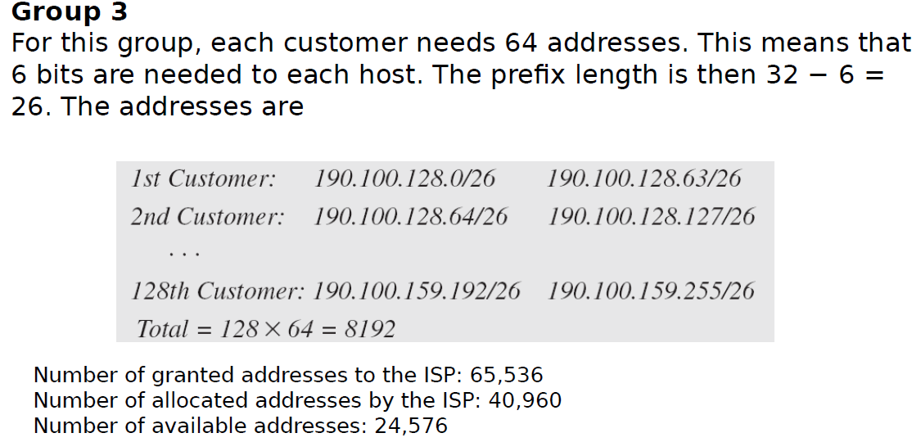
IP addressing (CIDR)

Slide 63
IP addresses: how to get one?
Host address can be configured manually.
Q: How does a host get IP address?
hard-coded by system admin in a file
Windows: control-panel->network->configuration->tcp/ip->properties
UNIX: /etc/rc.config
DHCP: Dynamic Host Configuration Protocol: dynamically get address from as server
“plug-and-play”
DHCP allows a host to obtain an IP address automatically.

Slide 64
DHCP: Dynamic Host Configuration Protocol
goal: host dynamically obtains IP address from network server when it “joins” network
can renew its lease on address in use
allows reuse of addresses (only hold address while connected/on)
support for mobile users who join/leave network
DHCP overview:
host broadcasts DHCP discover msg [optional]
DHCP server responds with DHCP offer msg [optional]
host requests IP address: DHCP request msg
DHCP server sends address: DHCP ack msg

Slide 65
DHCP client-server scenario
Typically, DHCP server will be co-located in router, serving all subnets to which router is attached
DHCP server
223.1.1.1
223.1.2.1
223.1.2.5
223.1.1.2
223.1.1.4
223.1.2.9
223.1.1.3
223.1.3.27
arriving DHCP client needs
address in this network
223.1.2.2
223.1.3.1
223.1.3.2

Slide 66

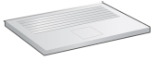
DHCP client-server scenario
DHCP server: 223.1.2.5
DHCP discover
Arriving client
src : 0.0.0.0, 68
dest.: 255.255.255.255,67
yiaddr: 0.0.0.0
transaction ID: 654
Broadcast: is there a DHCP server out there?
DHCP offer
src: 223.1.2.5, 67
dest: 255.255.255.255, 68
yiaddrr: 223.1.2.4
transaction ID: 654
lifetime: 3600 secs
Broadcast: I’m a DHCP server! Here’s an IP address you can use
The two steps above can be skipped “if a client remembers and wishes to reuse a previously allocated network address” [RFC 2131]
DHCP request
src: 0.0.0.0, 68
dest:: 255.255.255.255, 67
yiaddrr: 223.1.2.4
transaction ID: 655
lifetime: 3600 secs
Broadcast: OK. I would like to use this IP address!
DHCP ACK
src: 223.1.2.5, 67
dest: 255.255.255.255, 68
yiaddrr: 223.1.2.4
transaction ID: 655
lifetime: 3600 secs
Broadcast: OK. You’ve got that IP address!

Slide 67
NAT: network address translation
NAT: all devices in local network share just one IPv4 address as far as outside world is concerned
rest of
Internet
local network (e.g., home network) 10.0.0/24
10.0.0.1
138.76.29.7
10.0.0.4
10.0.0.2
10.0.0.3
all datagrams leaving local network have same source NAT IP address: 138.76.29.7, but different source port numbers
datagrams with source or destination in this network have 10.0.0/24 address for source, destination (as usual)

Slide 68
NAT: network address translation
all devices in local network have 32-bit addresses in a “private” IP address space (10/8, 172.16/12, 192.168/16 prefixes) that can only be used in local network
advantages:
just one IP address needed from provider ISP for all devices
can change addresses of host in local network without notifying outside world
can change ISP without changing addresses of devices in local network
security: devices inside local net not directly addressable, visible by outside world

Slide 69
NAT: network address translation
implementation: NAT router must (transparently):
outgoing datagrams: replace (source IP address, port #) of every outgoing datagram to (NAT IP address, new port #)
remote clients/servers will respond using (NAT IP address, new port #) as destination address
remember (in NAT translation table) every (source IP address, port #) to (NAT IP address, new port #) translation pair
incoming datagrams: replace (NAT IP address, new port #) in destination fields of every incoming datagram with corresponding (source IP address, port #) stored in NAT table

Slide 70
NAT: network address translation
NAT translation table
WAN side addr LAN side addr
2: NAT router changes datagram source address from 10.0.0.1, 3345 to 138.76.29.7, 5001,
updates table
1: host 10.0.0.1 sends datagram to 128.119.40.186, 80
138.76.29.7, 5001 10.0.0.1, 3345
…… ……
S: 10.0.0.1, 3345
D: 128.119.40.186, 80
10.0.0.1
1
2
S: 138.76.29.7, 5001
D: 128.119.40.186, 80
10.0.0.4
10.0.0.2
138.76.29.7
S: 128.119.40.186, 80
D: 10.0.0.1, 3345
4
S: 128.119.40.186, 80
D: 138.76.29.7, 5001
3
10.0.0.3
3: reply arrives, destination address: 138.76.29.7, 5001

Slide 71
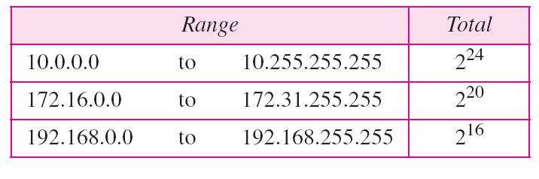
Table Addresses for private networks

Slide 72
IPv6: motivation
initial motivation: 32-bit IPv4 address space would be completely allocated
additional motivation:
speed processing/forwarding: 40-byte fixed length header
enable different network-layer treatment of “flows”
IPv6 datagram format:
fixed-length 40 byte header
no fragmentation allowed

Slide 73
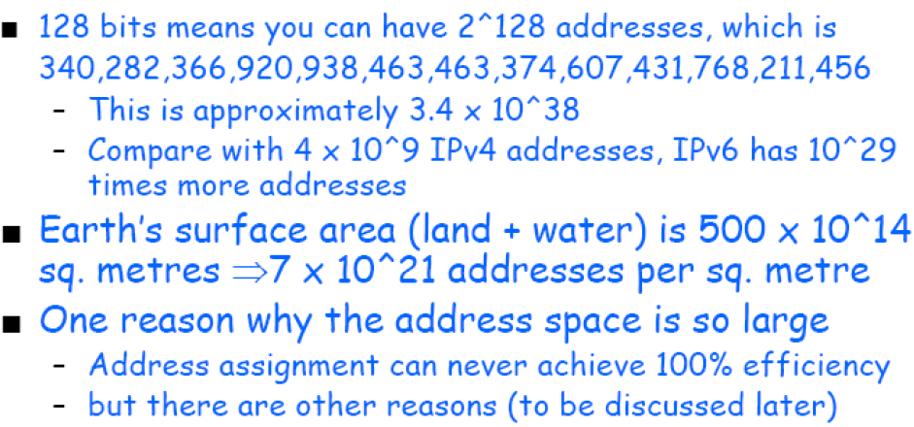
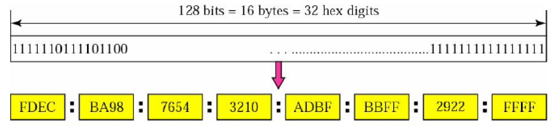
IPv6: motivation
Fig: IPv6 Address Format

Slide 74


IPv6: Addreviated Address

Slide 75




IPv6: Addreviated Address

Slide 76



IPv6: Addreviated Address

Slide 77
IPv6 datagram format
flow label: identify datagrams in same "flow.”
32 bits
priority: identify priority among datagrams in flow
ver
pri
flow label
payload len
next hdr
hop limit
source address
(128 bits)
128-bit
IPv6 addresses
destination address
(128 bits)
payload (data)
What’s missing (compared with IPv4):
no checksum (to speed processing at routers)
no fragmentation/reassembly
no options (available as upper-layer, next-header protocol at router)

Slide 78
Transition from IPv4 to IPv6
not all routers can be upgraded simultaneously
no “flag days”
how will network operate with mixed IPv4 and IPv6 routers?
tunneling: IPv6 datagram carried as payload in IPv4 datagram among IPv4 routers (“packet within a packet”)
tunneling used extensively in other contexts (4G/5G)
IPv4 header fields
IPv6 header fields
IPv4 payload
IPv4 source, dest addr
IPv6 source dest addr
UDP/TCP payload
IPv6 datagram
IPv4 datagram

Slide 79
Tunneling and encapsulation
Ethernet connecting two IPv6 routers:
A
B
Ethernet connects two IPv6 routers
E
F
IPv6
IPv6
IPv6
IPv6
IPv6 datagram
Link-layer frame
The usual: datagram as payload in link-layer frame
IPv4 network connecting two IPv6 routers
A
B
E
F
IPv6
IPv6/v4
IPv6/v4
IPv6
IPv4 network

Slide 80
Tunneling and encapsulation
Ethernet connecting two IPv6 routers:
A
B
Ethernet connects two IPv6 routers
E
F
IPv6
IPv6
IPv6
IPv6
IPv6 datagram
Link-layer frame
The usual: datagram as payload in link-layer frame
IPv4 tunnel connecting two IPv6 routers
A
B
IPv4 tunnel
connecting IPv6 routers
E
F
IPv6
IPv6/v4
IPv6/v4
IPv6
IPv6 datagram
IPv4 datagram
tunneling: IPv6 datagram as payload in a IPv4 datagram

Slide 81
Tunneling
A
B
IPv4 tunnel
connecting IPv6 routers
E
F
logical view:
IPv6
IPv6/v4
IPv6/v4
IPv6
A
B
C
D
E
F
physical view:
IPv6
IPv6/v4
IPv4
IPv4
IPv6/v4
IPv6
flow: X
src: A
dest: F
data
src:B
dest: E
src:B
dest: E
src:B
dest: E
flow: X
src: A
dest: F
data
Flow: X
Src: A
Dest: F
data
Flow: X
Src: A
Dest: F
data
Flow: X
Src: A
Dest: F
data
Note source and destination addresses!
A-to-B:
IPv6
B-to-C:
IPv6 inside
IPv4
B-to-C:
IPv6 inside
IPv4
B-to-C:
IPv6 inside
IPv4
E-to-F:
IPv6

Slide 82


